Slide 1

Machine Learning
Regression
Pramote Kuacharoen

Slide 2
History
The term "regression" was coined by Francis Galton in the nineteenth century to describe a biological phenomenon
The phenomenon was that the heights of descendants of tall ancestors tend to regress down towards a normal average (a phenomenon also known as regression toward the mean)

Slide 3
Example
Shaquille O’Neal is 7’1” or 2.2 Meters
If Shaquille has a son, chances are he will be tall too
However, Shaquille is such an anomaly that there is also a very good chance that his son will not be as tall as Shaquille

Slide 4
Example
It turns out that Shaquille’s son is very tall (6’7”), but not nearly as tall as his dad
Galton called this phenomenon regression
The heights of descendants of tall ancestors tend to regress down towards a normal average

Slide 5
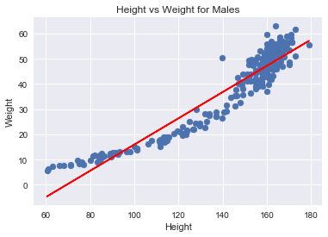
Linear Regression
Linear regression is an approach to modeling the relationship between the dependent variable y and one or more explanatory variables denoted X
Based on the data, it learns a hypothesis function which fits the data well
This hypothesis function can be used as a predictive model for predicting y from X, when y is not known
Data from which the model is learned, is called the labeled data, with known values of y
While trying to build the model any set of the list of [x1, x2,… xn ] variables/features can be brought into the model
height | age | sex | weight
151.765 | 63 | M | 47.82561
139.700 | 63 | F | 36.48581
136.525 | 65 | F | 31.86484
156.845 | 41 | M | 53.04191
145.415 | 51 | F | 41.27687

Slide 6
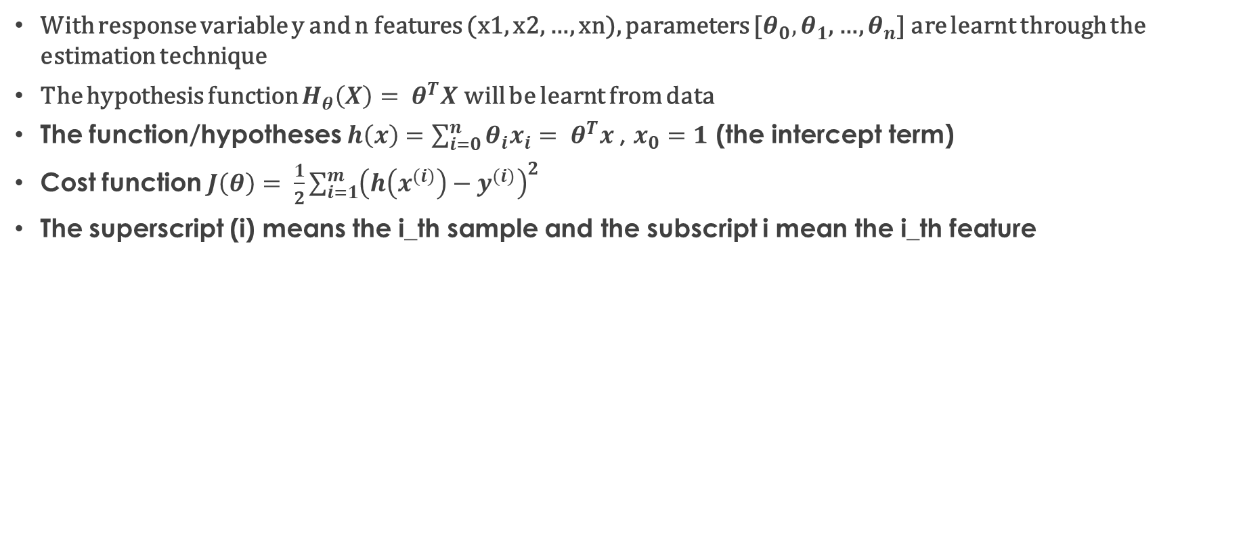
Model Representation
With response variable y and n features (x1, x2, …, xn), parameters [$θ_{0},θ_{1}$, …, $θ_{n}$] are learnt through the estimation technique
The hypothesis function $H_{θ}\left(X\right)= θ^{T}X$ will be learnt from data
The function/hypotheses $h\left(x\right)=\sum_{i=0}^{n}{θ_{i}x_{i}= θ^{T}x}$, $x_{0}=1$ (the intercept term)
Cost function $J\left(θ\right)= \frac{1}{2}\sum_{i=1}^{m}{{\left(h\left(x^{(i)}\right)−y^{(i)}\right)}^{2}}$
The superscript (i) means the i_th sample and the subscript i mean the i_th feature

Slide 7
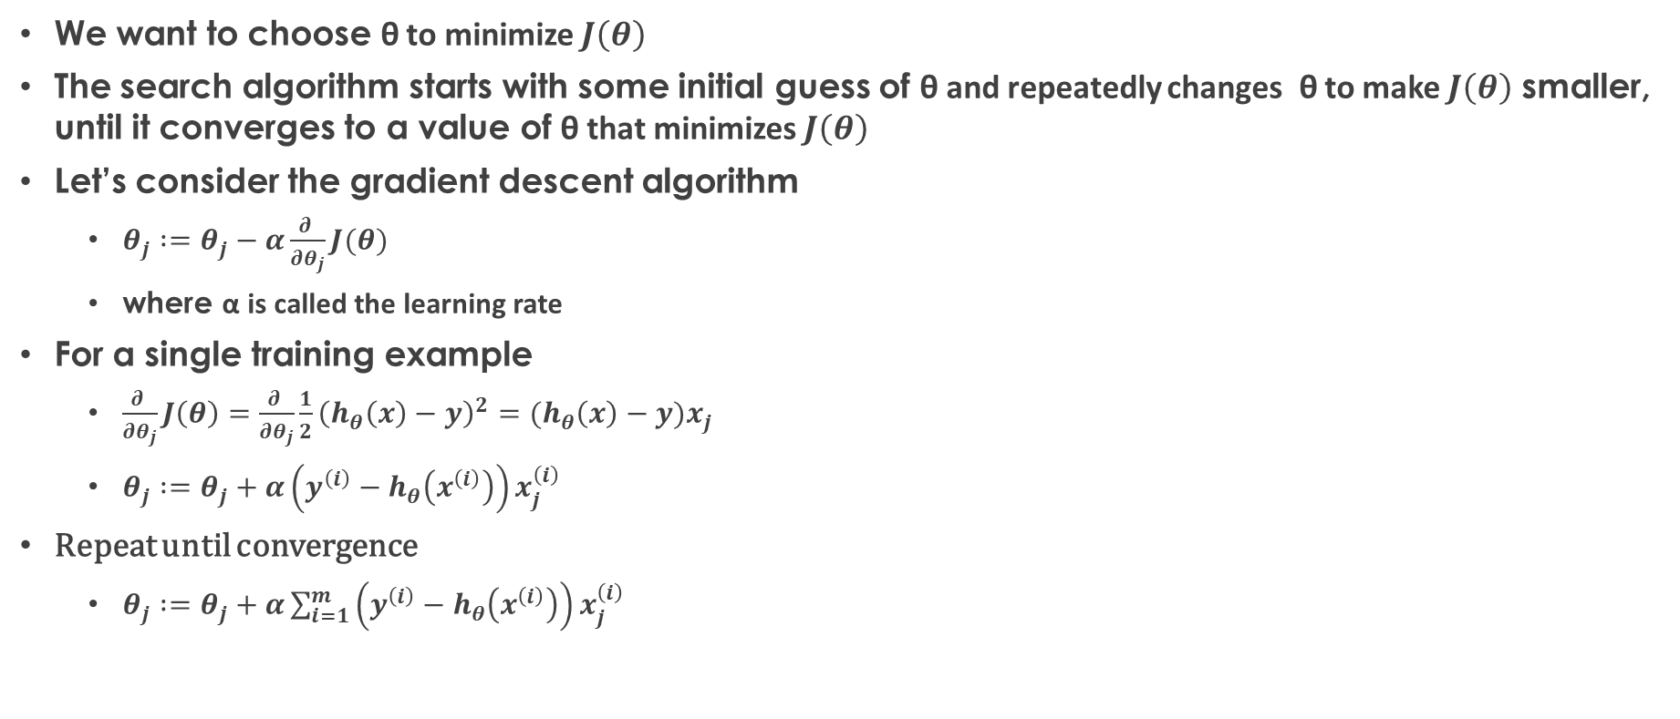
Least Mean Square (LMS) Algorithm
We want to choose θ to minimize $J\left(θ\right)$
The search algorithm starts with some initial guess of θ and repeatedly changes θ to make $J\left(θ\right)$ smaller, until it converges to a value of θ that minimizes $J\left(θ\right)$
Let’s consider the gradient descent algorithm
$θ_{j} :=θ_{j}−α\frac{∂ }{∂θ_{j}}J(θ)$
where α is called the learning rate
For a single training example
$\frac{∂ }{∂θ_{j}}J\left(θ\right)=\frac{∂ }{∂θ_{j}}\frac{1}{2}{\left(h_{θ}\left(x\right)−y\right)}^{2}=(h_{θ}\left(x\right)−y)x_{j}$
$θ_{j} :=θ_{j}+α\left(y^{\left(i\right)}−h_{θ}\left(x^{\left(i\right)}\right)\right)x_{j}^{\left(i\right)}$
Repeat until convergence
$θ_{j} :=θ_{j}+α\sum_{i=1}^{m}{\left(y^{\left(i\right)}−h_{θ}\left(x^{\left(i\right)}\right)\right)x_{j}^{\left(i\right)}}$

Slide 8
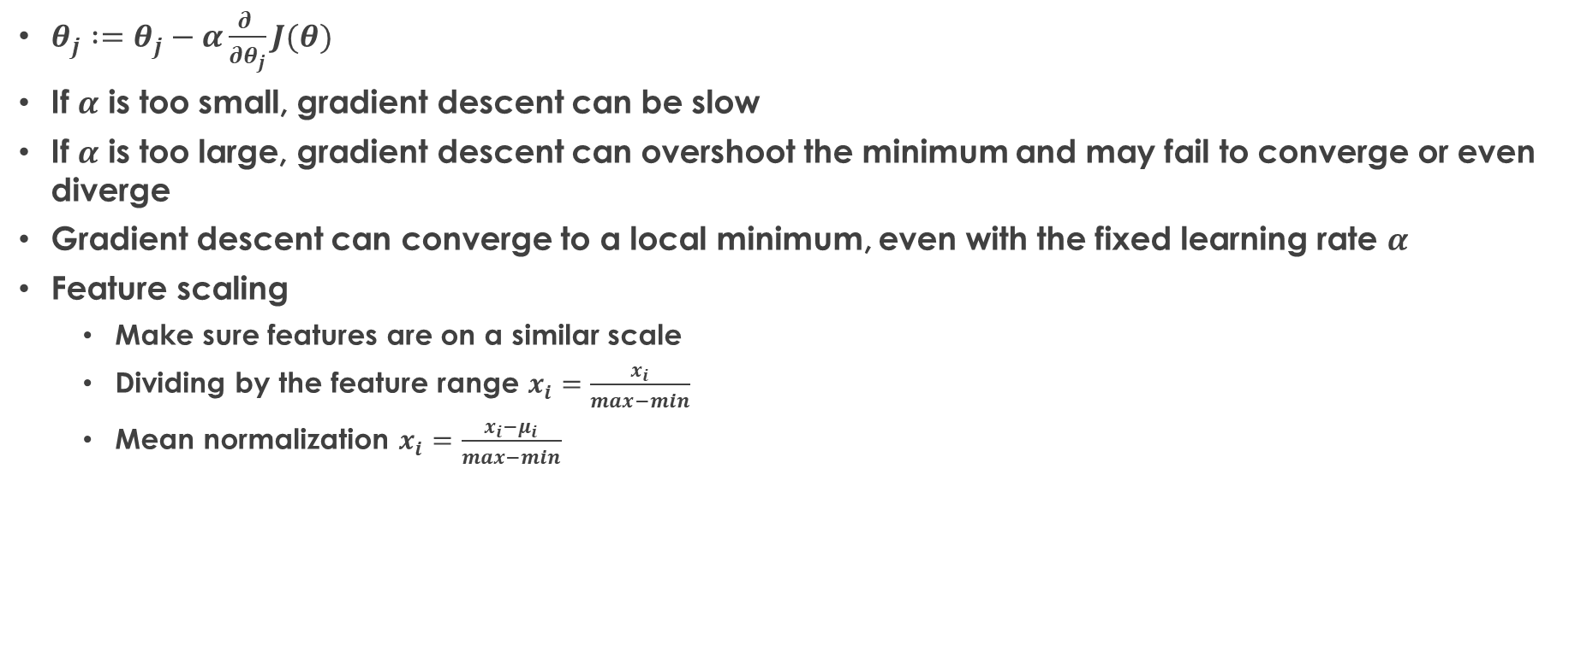
Gradient Descent Algorithm
$θ_{j} :=θ_{j}−α\frac{∂ }{∂θ_{j}}J(θ)$
If $α$ is too small, gradient descent can be slow
If $α$ is too large, gradient descent can overshoot the minimum and may fail to converge or even diverge
Gradient descent can converge to a local minimum, even with the fixed learning rate $α$
Feature scaling
Make sure features are on a similar scale
Dividing by the feature range $x_{i}=\frac{x_{i}}{max−min}$
Mean normalization $x_{i}=\frac{x_{i}−μ_{i}}{max−min}$

Slide 9
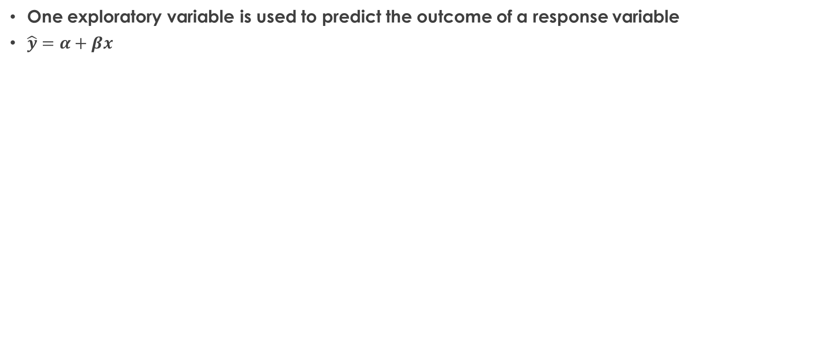
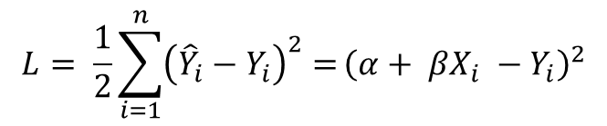
Two Dimensional Example
One exploratory variable is used to predict the outcome of a response variable
$\hat{y}=α+βx$
$$L= \frac{1}{2}\sum_{i=1}^{n}{{\left({\hat{Y}}_{i}−Y_{i}\right)}^{2}=}{\left({α+ βX_{i} −Y}_{i}\right)}^{2}$$

Slide 10
Multiple Regression
Multiple regression is a type of regression in which more than one exploratory variable is used to predict the outcome of a response variable

Slide 11
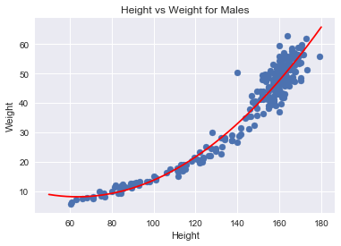
Polynomial Regression
Polynomial regression uses degrees of polynomial to make a non-linear regression line

Slide 12
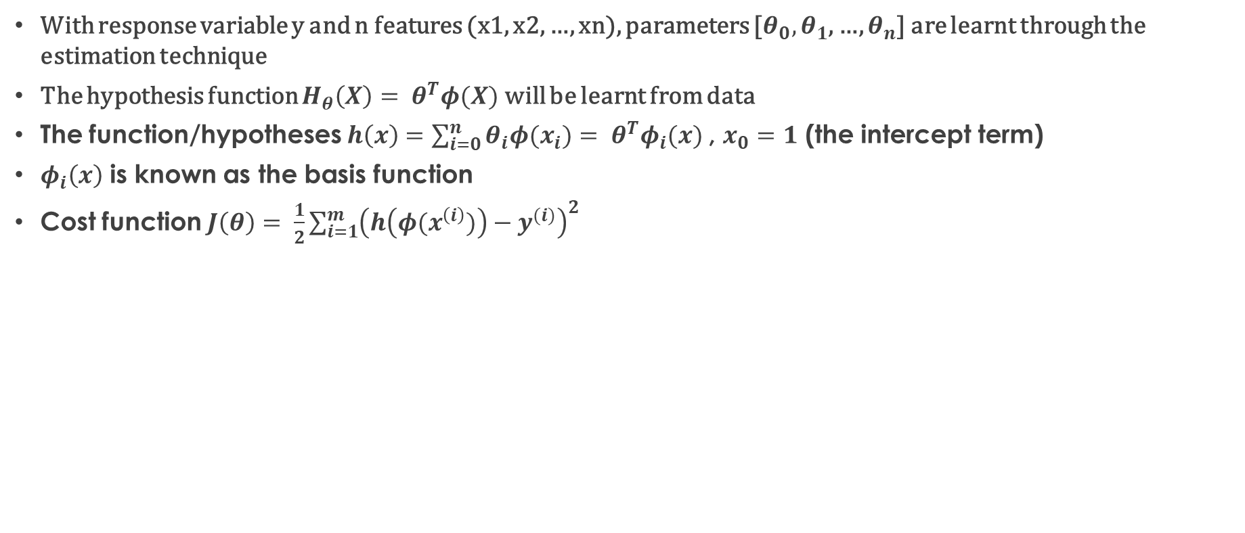
Linear Model for Regression
With response variable y and n features (x1, x2, …, xn), parameters [$θ_{0},θ_{1}$, …, $θ_{n}$] are learnt through the estimation technique
The hypothesis function $H_{θ}\left(X\right)= θ^{T}φ(X)$ will be learnt from data
The function/hypotheses $h\left(x\right)=\sum_{i=0}^{n}{θ_{i}φ(x_{i})= θ^{T}φ_{i}(x})$, $x_{0}=1$ (the intercept term)
$φ_{i}\left(x\right)$ is known as the basis function
Cost function $J\left(θ\right)= \frac{1}{2}\sum_{i=1}^{m}{{\left(h\left(φ(x^{\left(i\right)})\right)−y^{(i)}\right)}^{2}}$

Slide 13
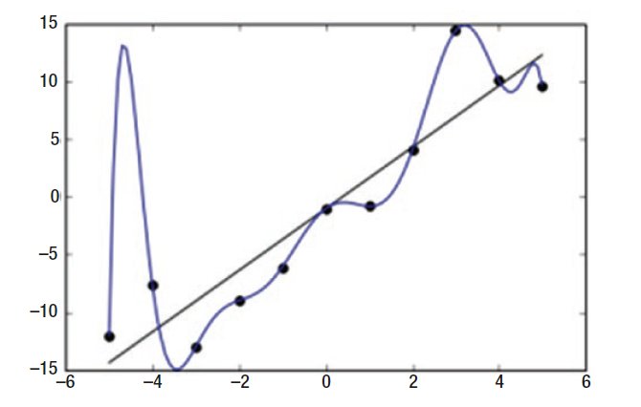
Overfitting and Underfitting
Overfitting refers to the phenomenon where a model is highly fitted on a dataset
This generalization thus deprives the model from making highly accurate predictions about unseen data

Slide 14
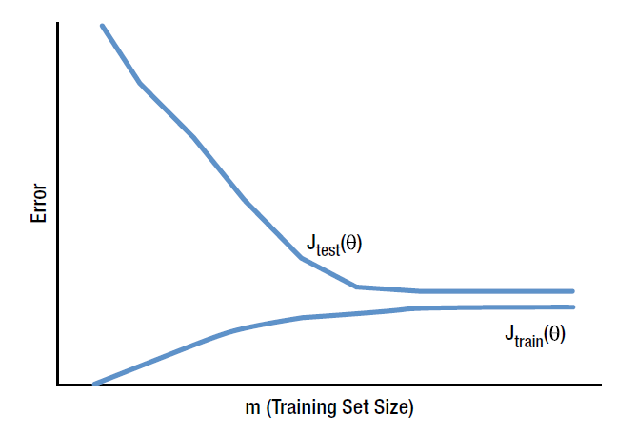
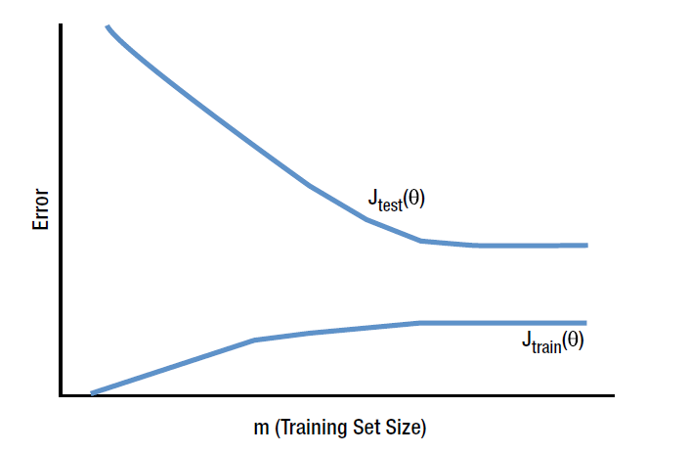
Underfitting
Underfitting is a phenomenon where the model is not trained with high precision on data at hand
The treatment of underfitting is subject to bias and variance
A model will have a high bias if both train and test errors are high
a model will have a high variance if there is a large gap between test and train errors
High Bias
High Variance

Slide 15
Remedy for High Bias and High Variance
If a model has a high bias type underfitting, then the remedy can be to increase the model complexity
If a model is suffering from high variance type underfitting, then the cure can be to bring in more data or otherwise make the model less complex

Slide 16
Feature Selection
Also called variable selection or attribute selection
The process of selecting a subset of relevant features (variables, predictors) for use in model construction
Feature selection techniques are used for four reasons
Simplification of models to make them easier to interpret by researchers/users,[1]
Shorter training times
To avoid the curse of dimensionality
Enhanced generalization by reducing overfitting
Feature selection is different from dimensionality reduction
Both methods seek to reduce the number of attributes in the dataset, but a dimensionality reduction method do so by creating new combinations of attributes, where as feature selection methods include and exclude attributes present in the data without changing them

Slide 17
Regression Metrics of Evaluation
Explained variance score
Mean absolute error
Mean squared error
R²
Residual

Slide 18
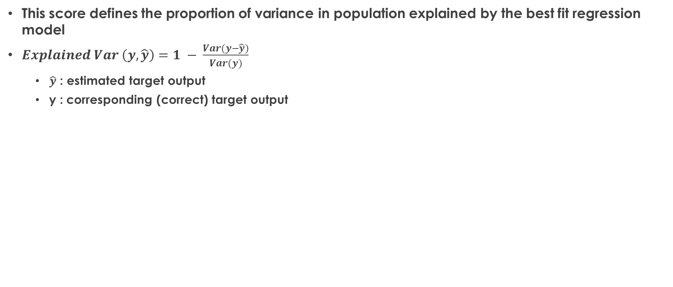
Explained Variance Score
This score defines the proportion of variance in population explained by the best fit regression model
$Explained Var \left(y, \hat{y}\right)=1 − \frac{Var(y−\hat{y})}{Var(y)}$
$\hat{y}$ : estimated target output
y : corresponding (correct) target output

Slide 19
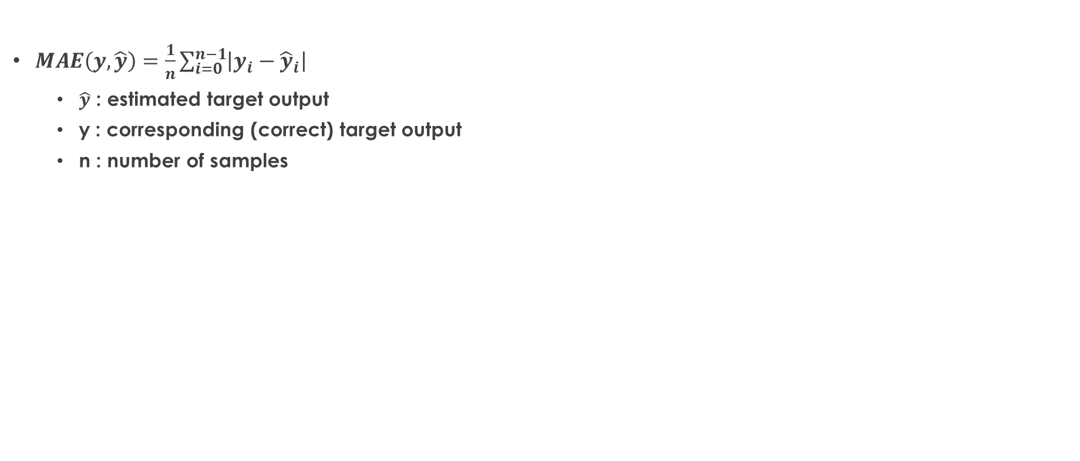
Mean Absolute Error
$MAE\left(y, \hat{y}\right)=\frac{1}{n}\sum_{i=0}^{n−1}{\left|y_{i}−{\hat{y}}_{i}\right|}$
$\hat{y}\text{ : }\text{estimated} \text{target} \text{output}$
$\text{y}\text{ : }\text{corresponding}\text{ (}\text{correct}\text{) }\text{target} \text{output}$
n : number of samples

Slide 20
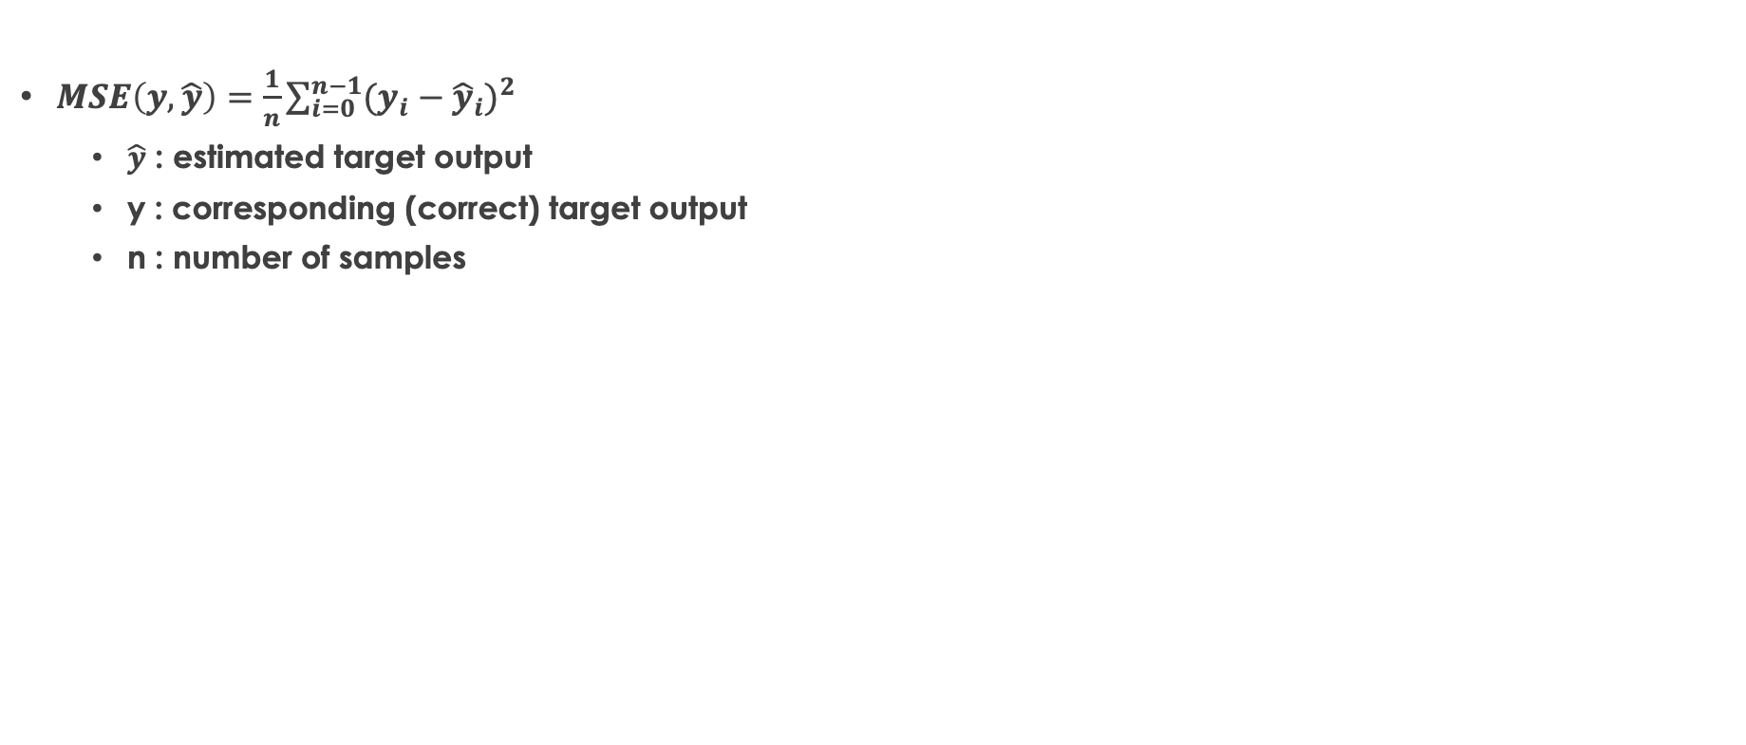
Mean Squared Error
$MSE\left(y, \hat{y}\right)=\frac{1}{n}\sum_{i=0}^{n−1}{{(y_{i}−{\hat{y}}_{i})}^{2}}$
$\hat{y}\text{ : }\text{estimated} \text{target} \text{output}$
$\text{y}\text{ : }\text{corresponding}\text{ (}\text{correct}\text{) }\text{target} \text{output}$
n : number of samples

Slide 21
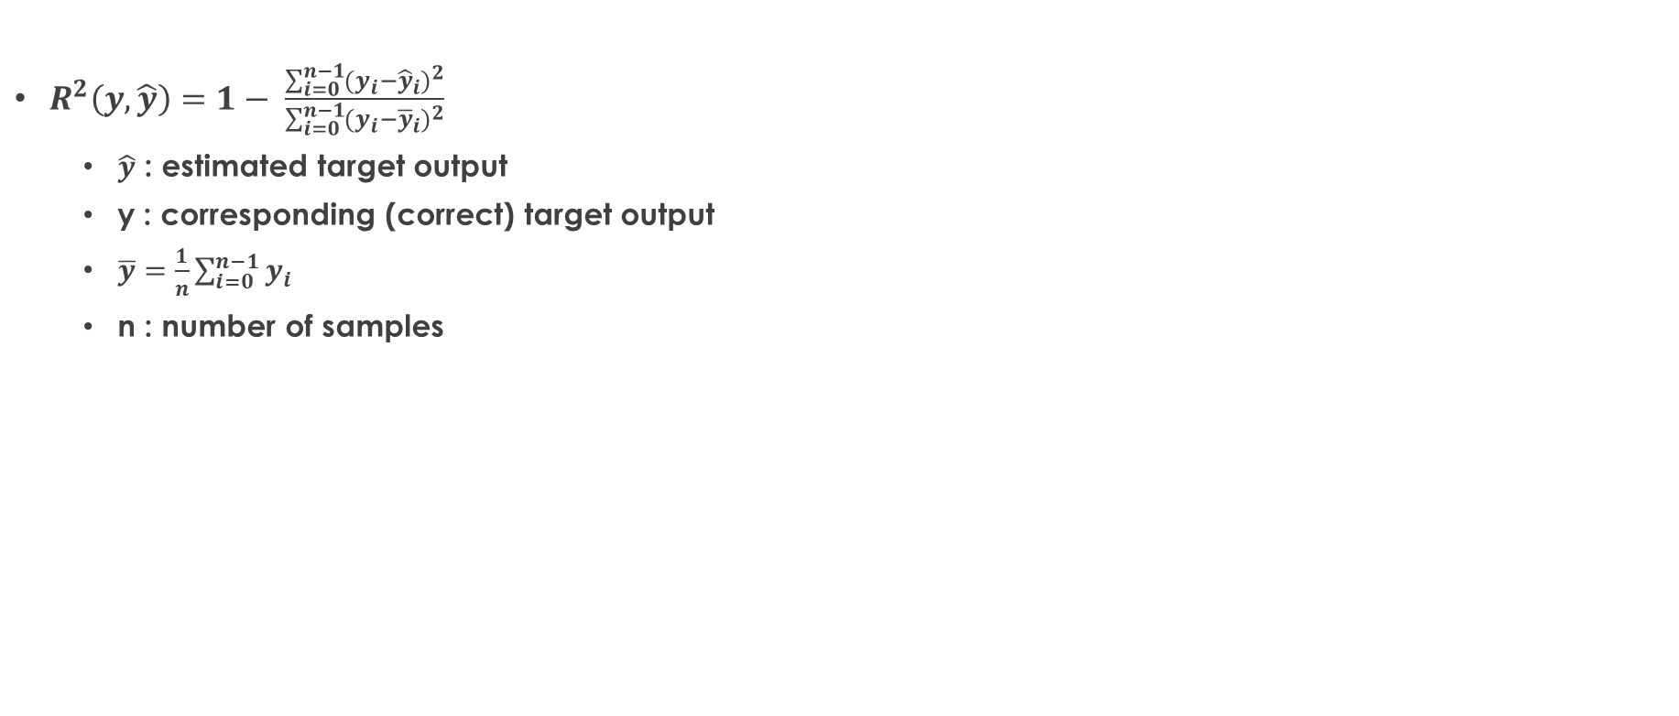
R²
$R^{2}\left(y, \hat{y}\right)=1− \frac{\sum_{i=0}^{n−1}{{(y_{i}−{\hat{y}}_{i})}^{2}}}{\sum_{i=0}^{n−1}{{(y_{i}−{\overline{y}}_{i})}^{2}}}$
$\hat{y}\text{ : }\text{estimated} \text{target} \text{output}$
$\text{y}\text{ : }\text{corresponding}\text{ (}\text{correct}\text{) }\text{target} \text{output}$
$\overline{y}=\frac{1}{n}\sum_{i=0}^{n−1}{y_{i}}$
n : number of samples

Slide 22
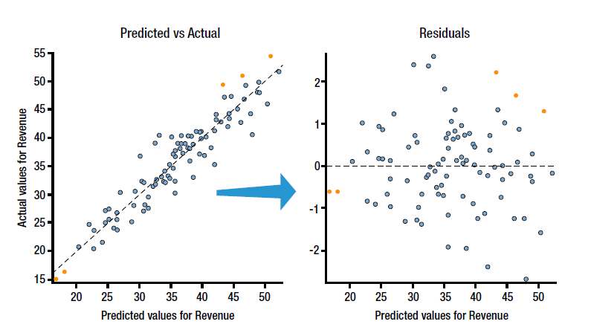
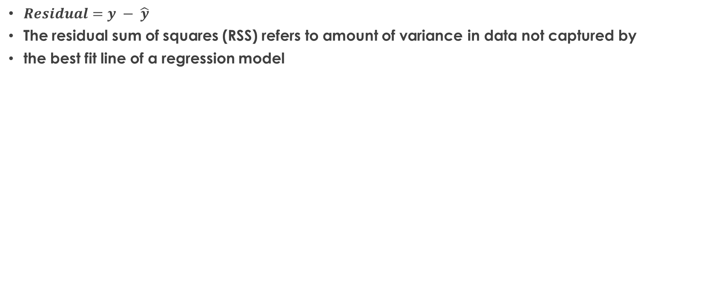
Residual
$Residual=y − \hat{y}$
The residual sum of squares (RSS) refers to amount of variance in data not captured by
the best fit line of a regression model

Slide 23
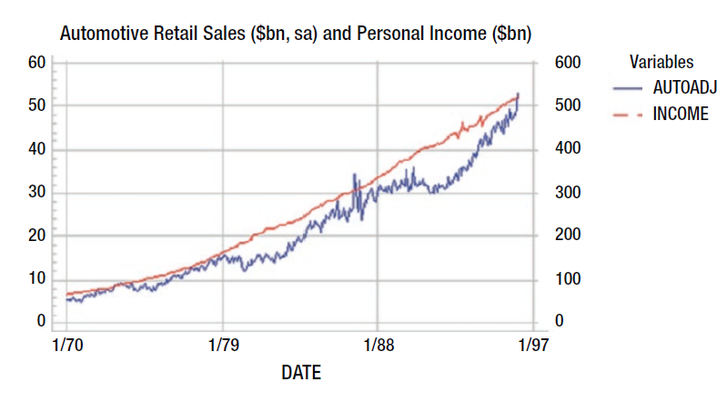
Applications of Regression
Sales forecasting
Predicting value of bond
Rate of inflation
Insurance companies
Call center
Agriculture
Predicting salary
Real estate industry

Slide 24
Question?
Insert Image

